Slide 1
UNVEILING MARKET INSIGHTS:ANALYSING SPENDING BEHAVIOUR AND IDENTIFYING OPPORTUNITIES FOR GrOWTH
Team:
V.Sarojini
S.Santhiya
S.Sarathi
S.Sarojini
S.Vanitha

Slide 2
Introduction:
Wholesaling or distributing is the sale of good retailer to industrial,commercial,institutional or other professional businessman to other wholesalers and related subordinated services.
In today’s fast-paced and highly competitive business landscape market research plays a pivotal role in understanding consumer behaviour, identifying emerging trends and making informed strategic decisions.
Market Analysis is a detailed assessment your business’s target market and the competitive landscape within a specific industry.

Slide 3
Purpose:
Marketing insights provide a solid foundation for strategic decision making minimizing risks associated with uncertainity.
The purpose of marketing can be defined as:
Creating brand awareness.
Retaining existing customers.
Developing new customers.
Strengthening brand association and recall.
The purpose of marketing is to generate revenue for a brand, company or organization.
Market research provides critical information about your market and your business landscape.

Slide 4
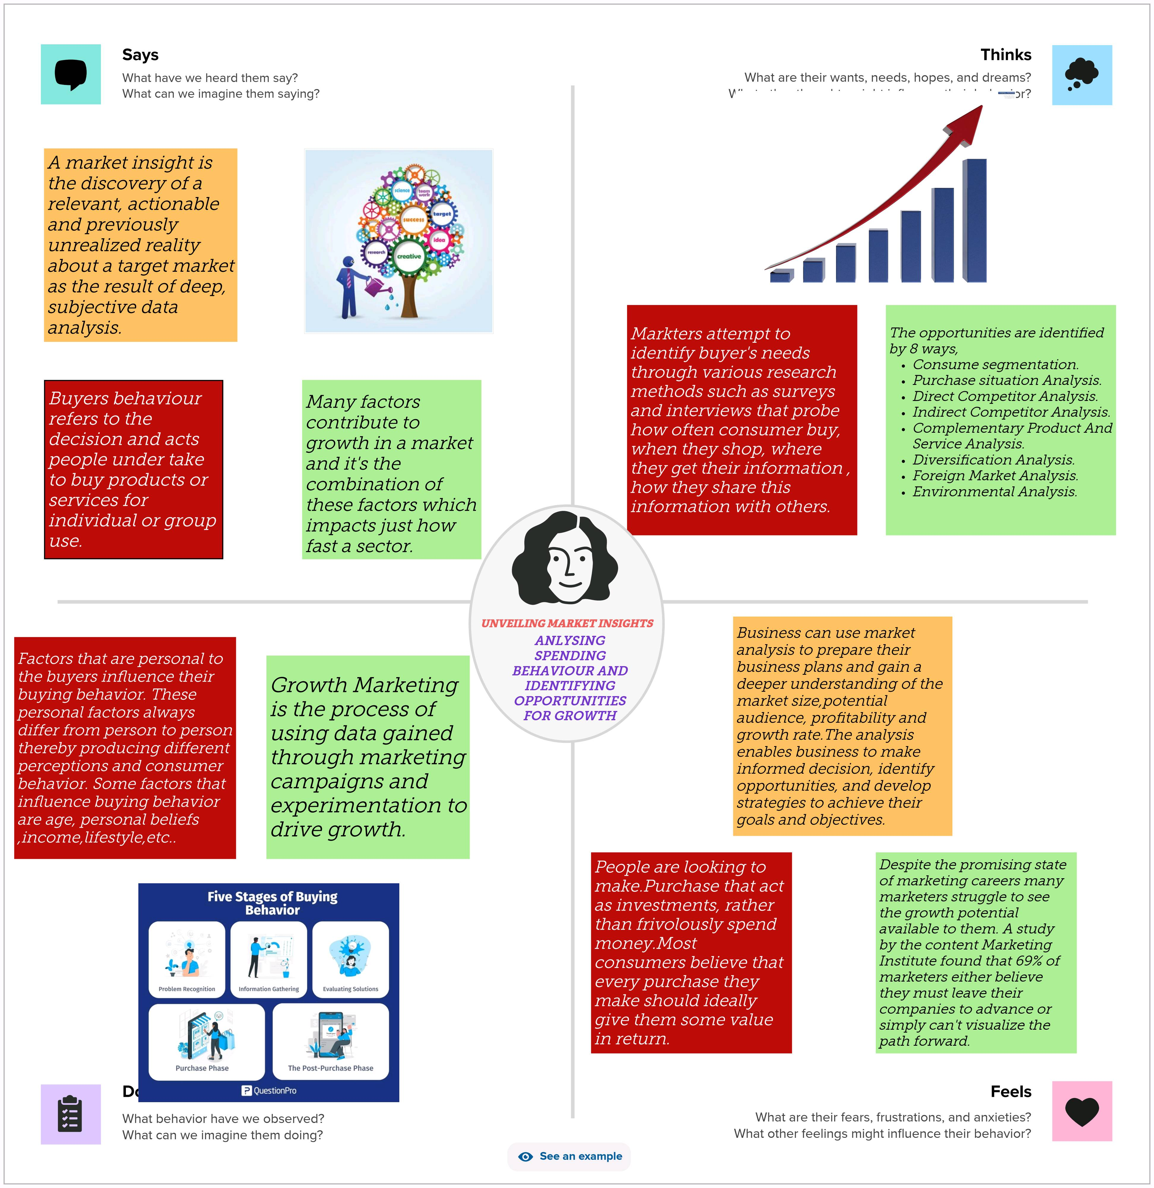
Empathy Map

Slide 5
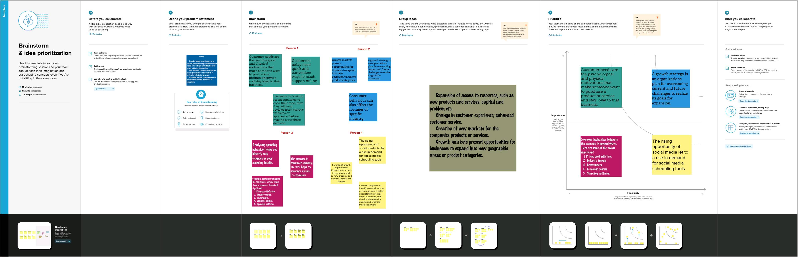
Brainstorming

Slide 6
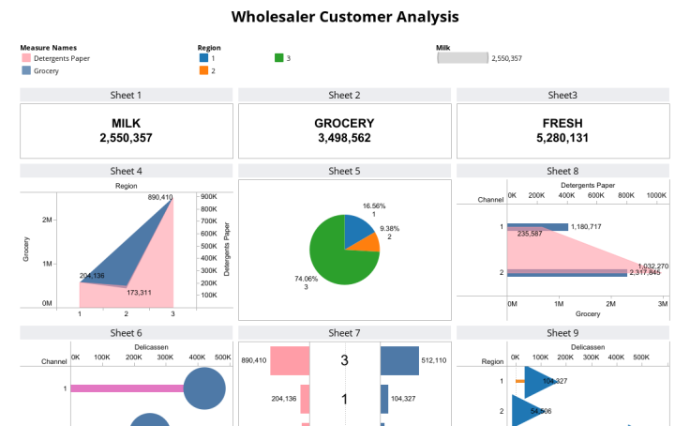
Result:

Slide 7
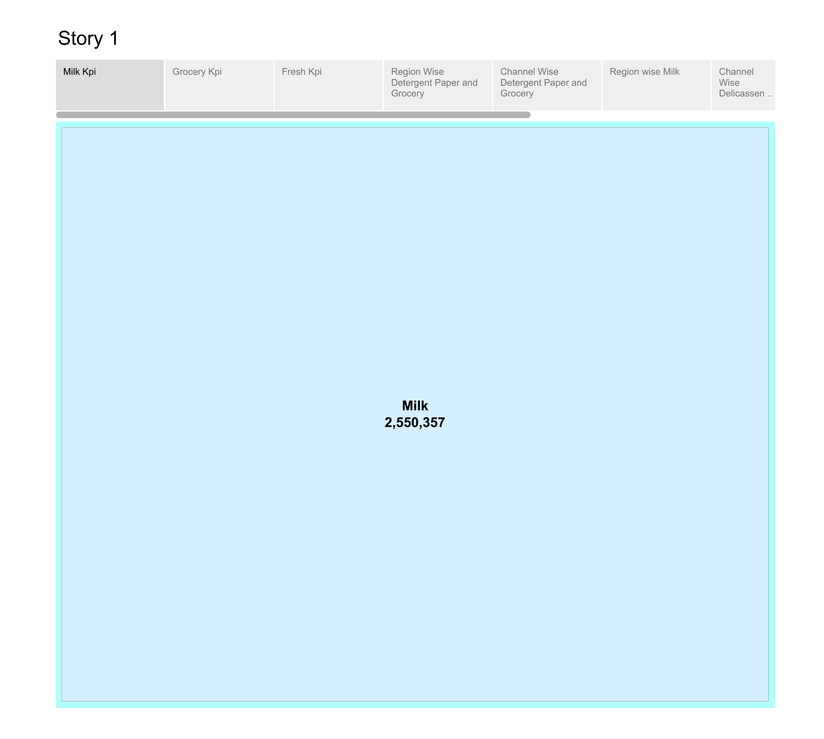
Milk kpi

Slide 8

Grocery kpi

Slide 9

Fresh kpi

Slide 10
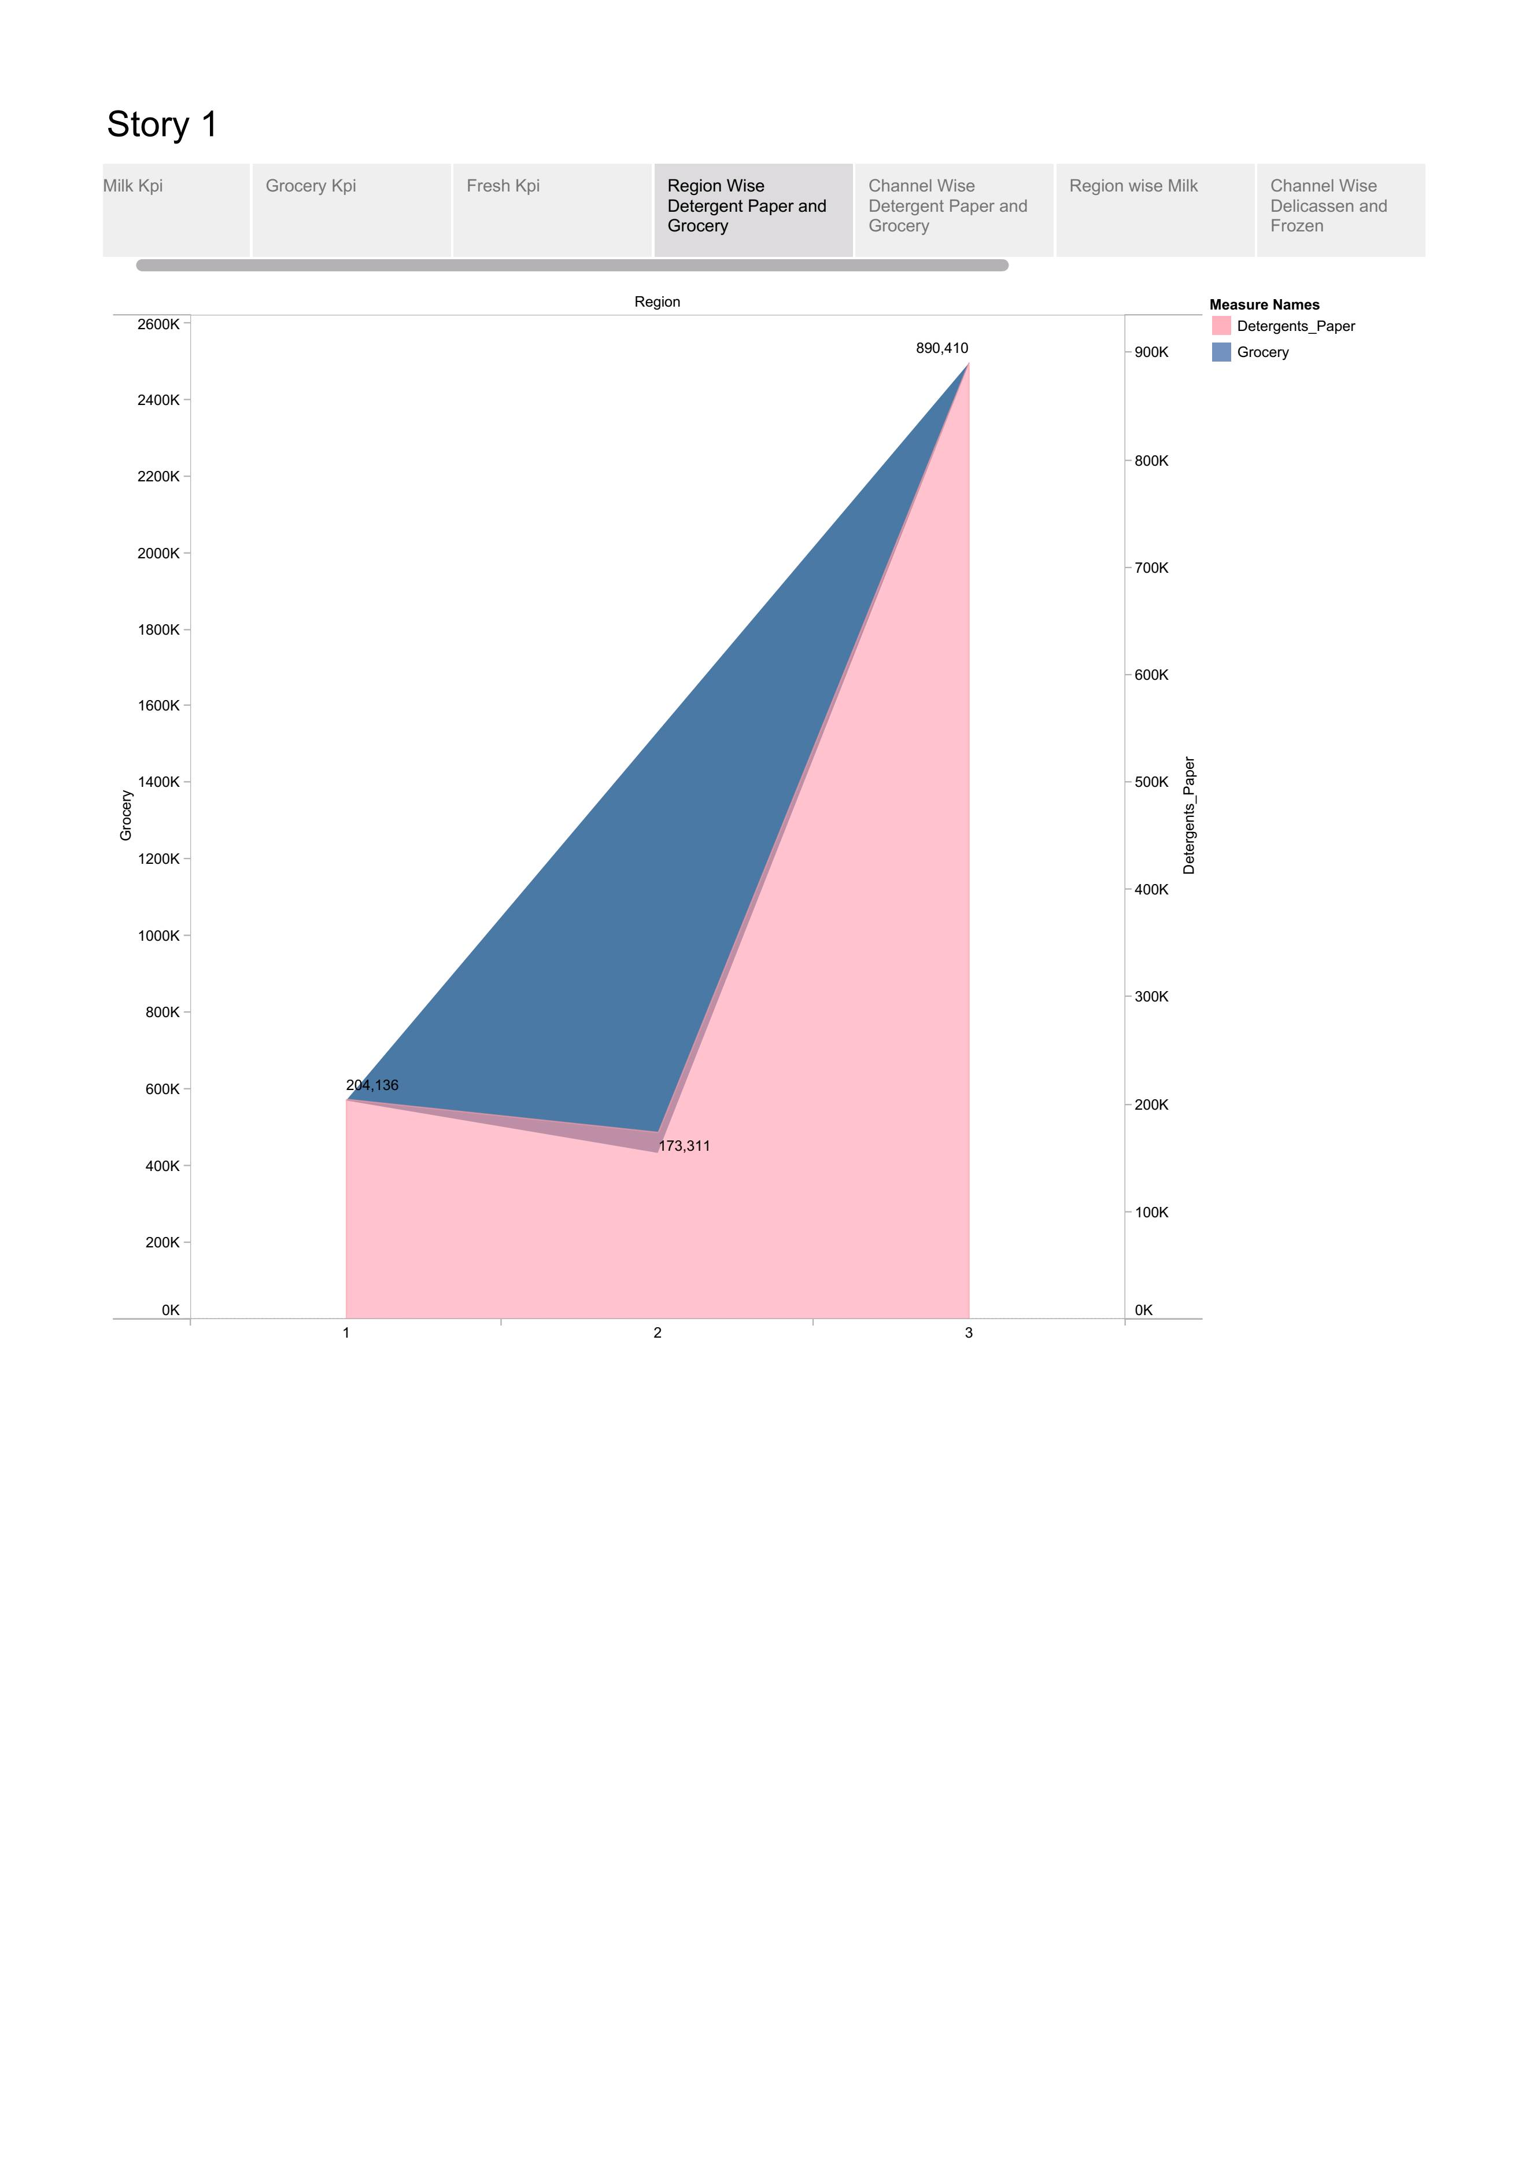
Region wise
Detergent Paper and Grocery

Slide 11
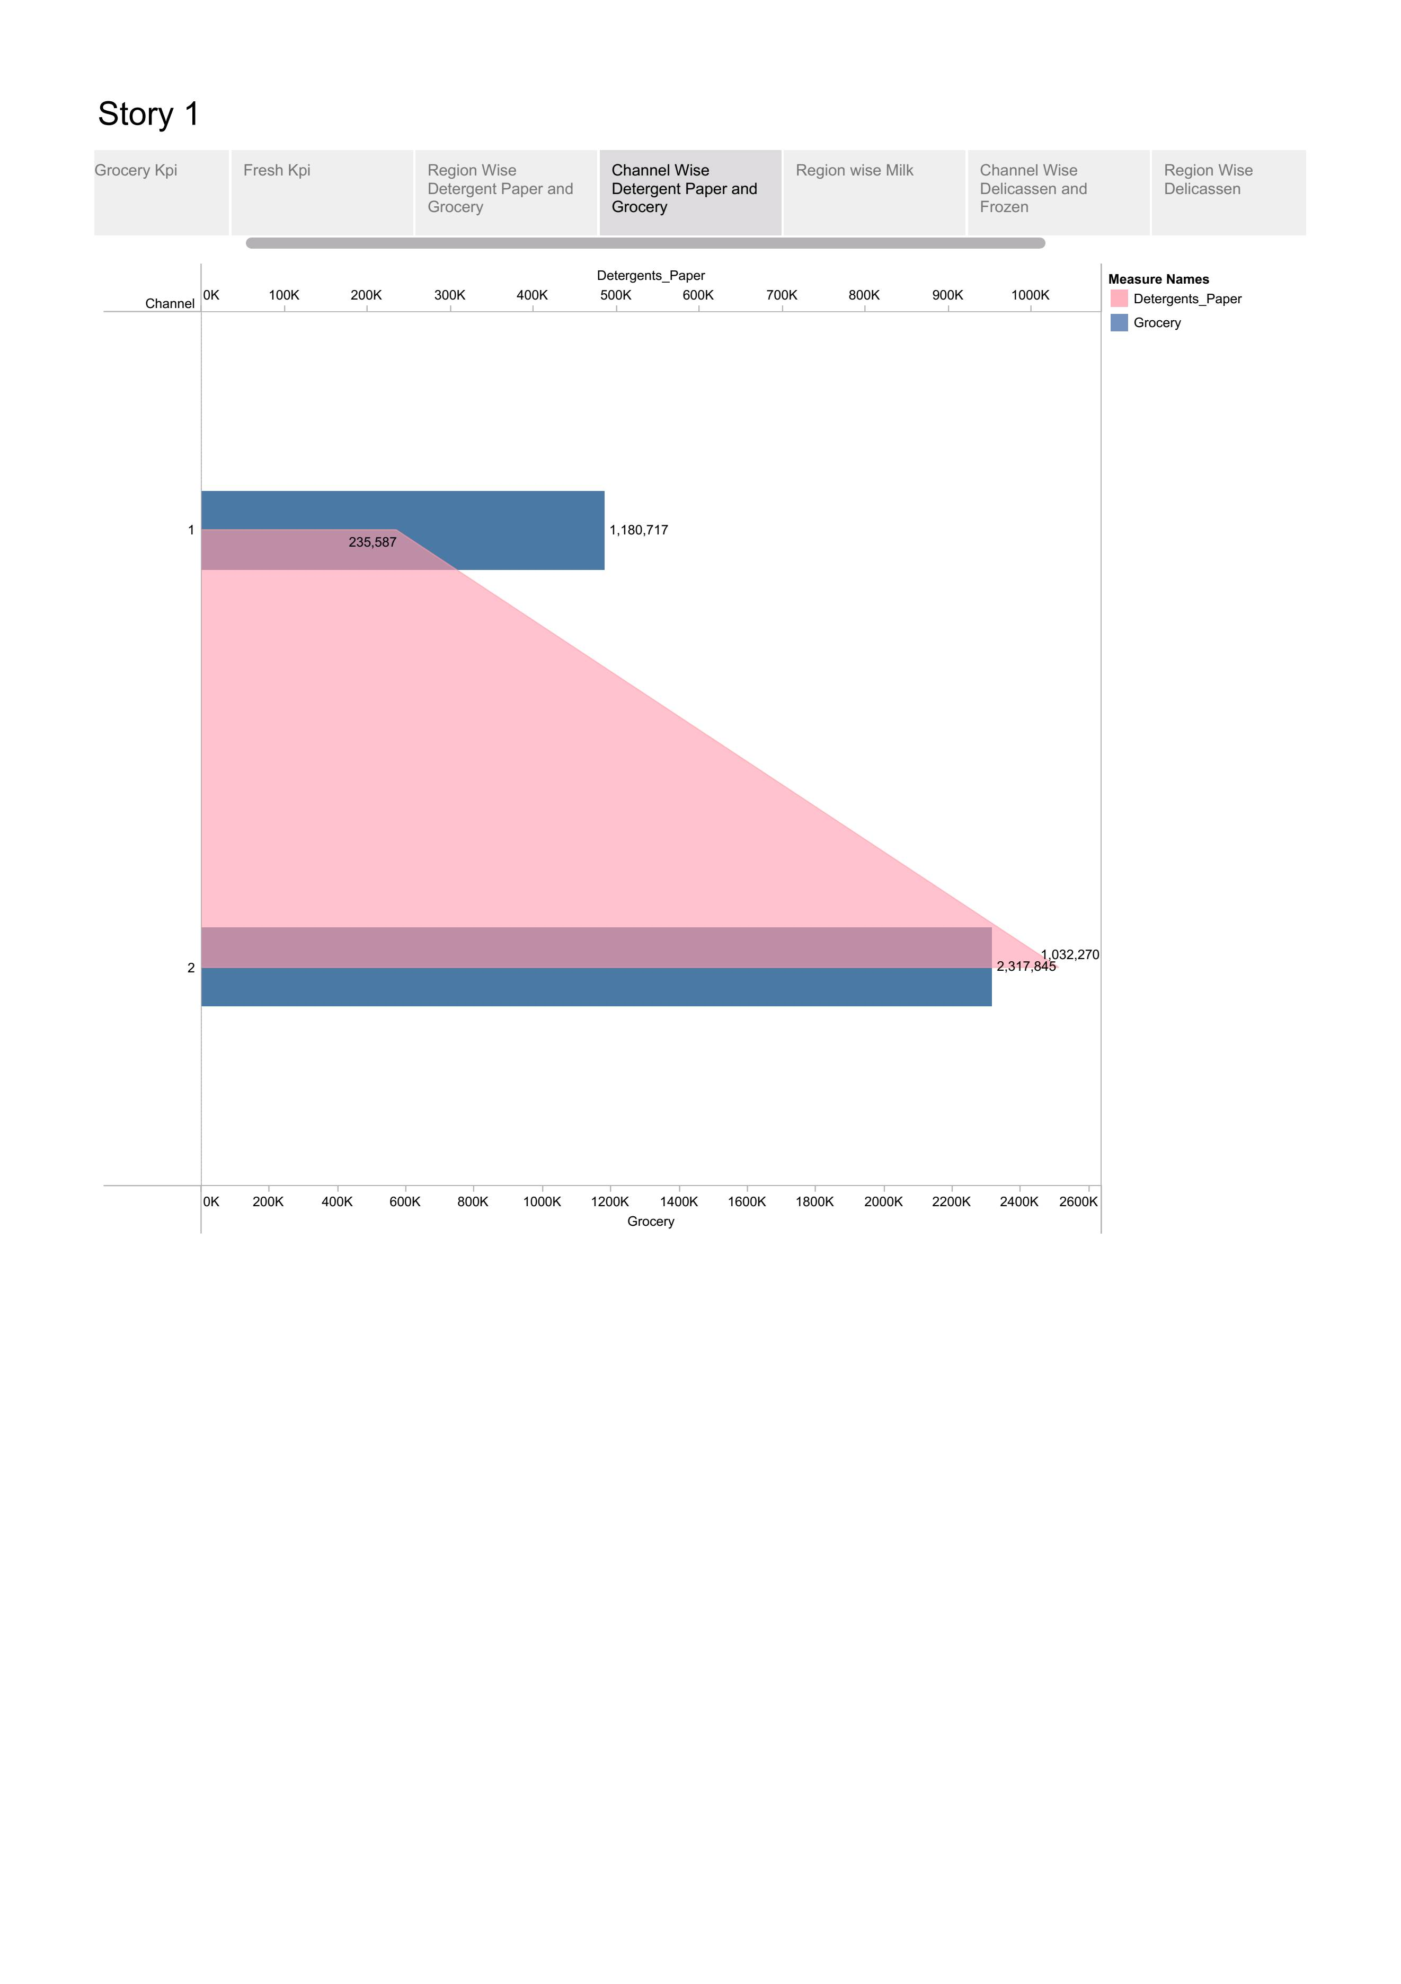
Channel wise
Detergent Paper And Grocery

Slide 12
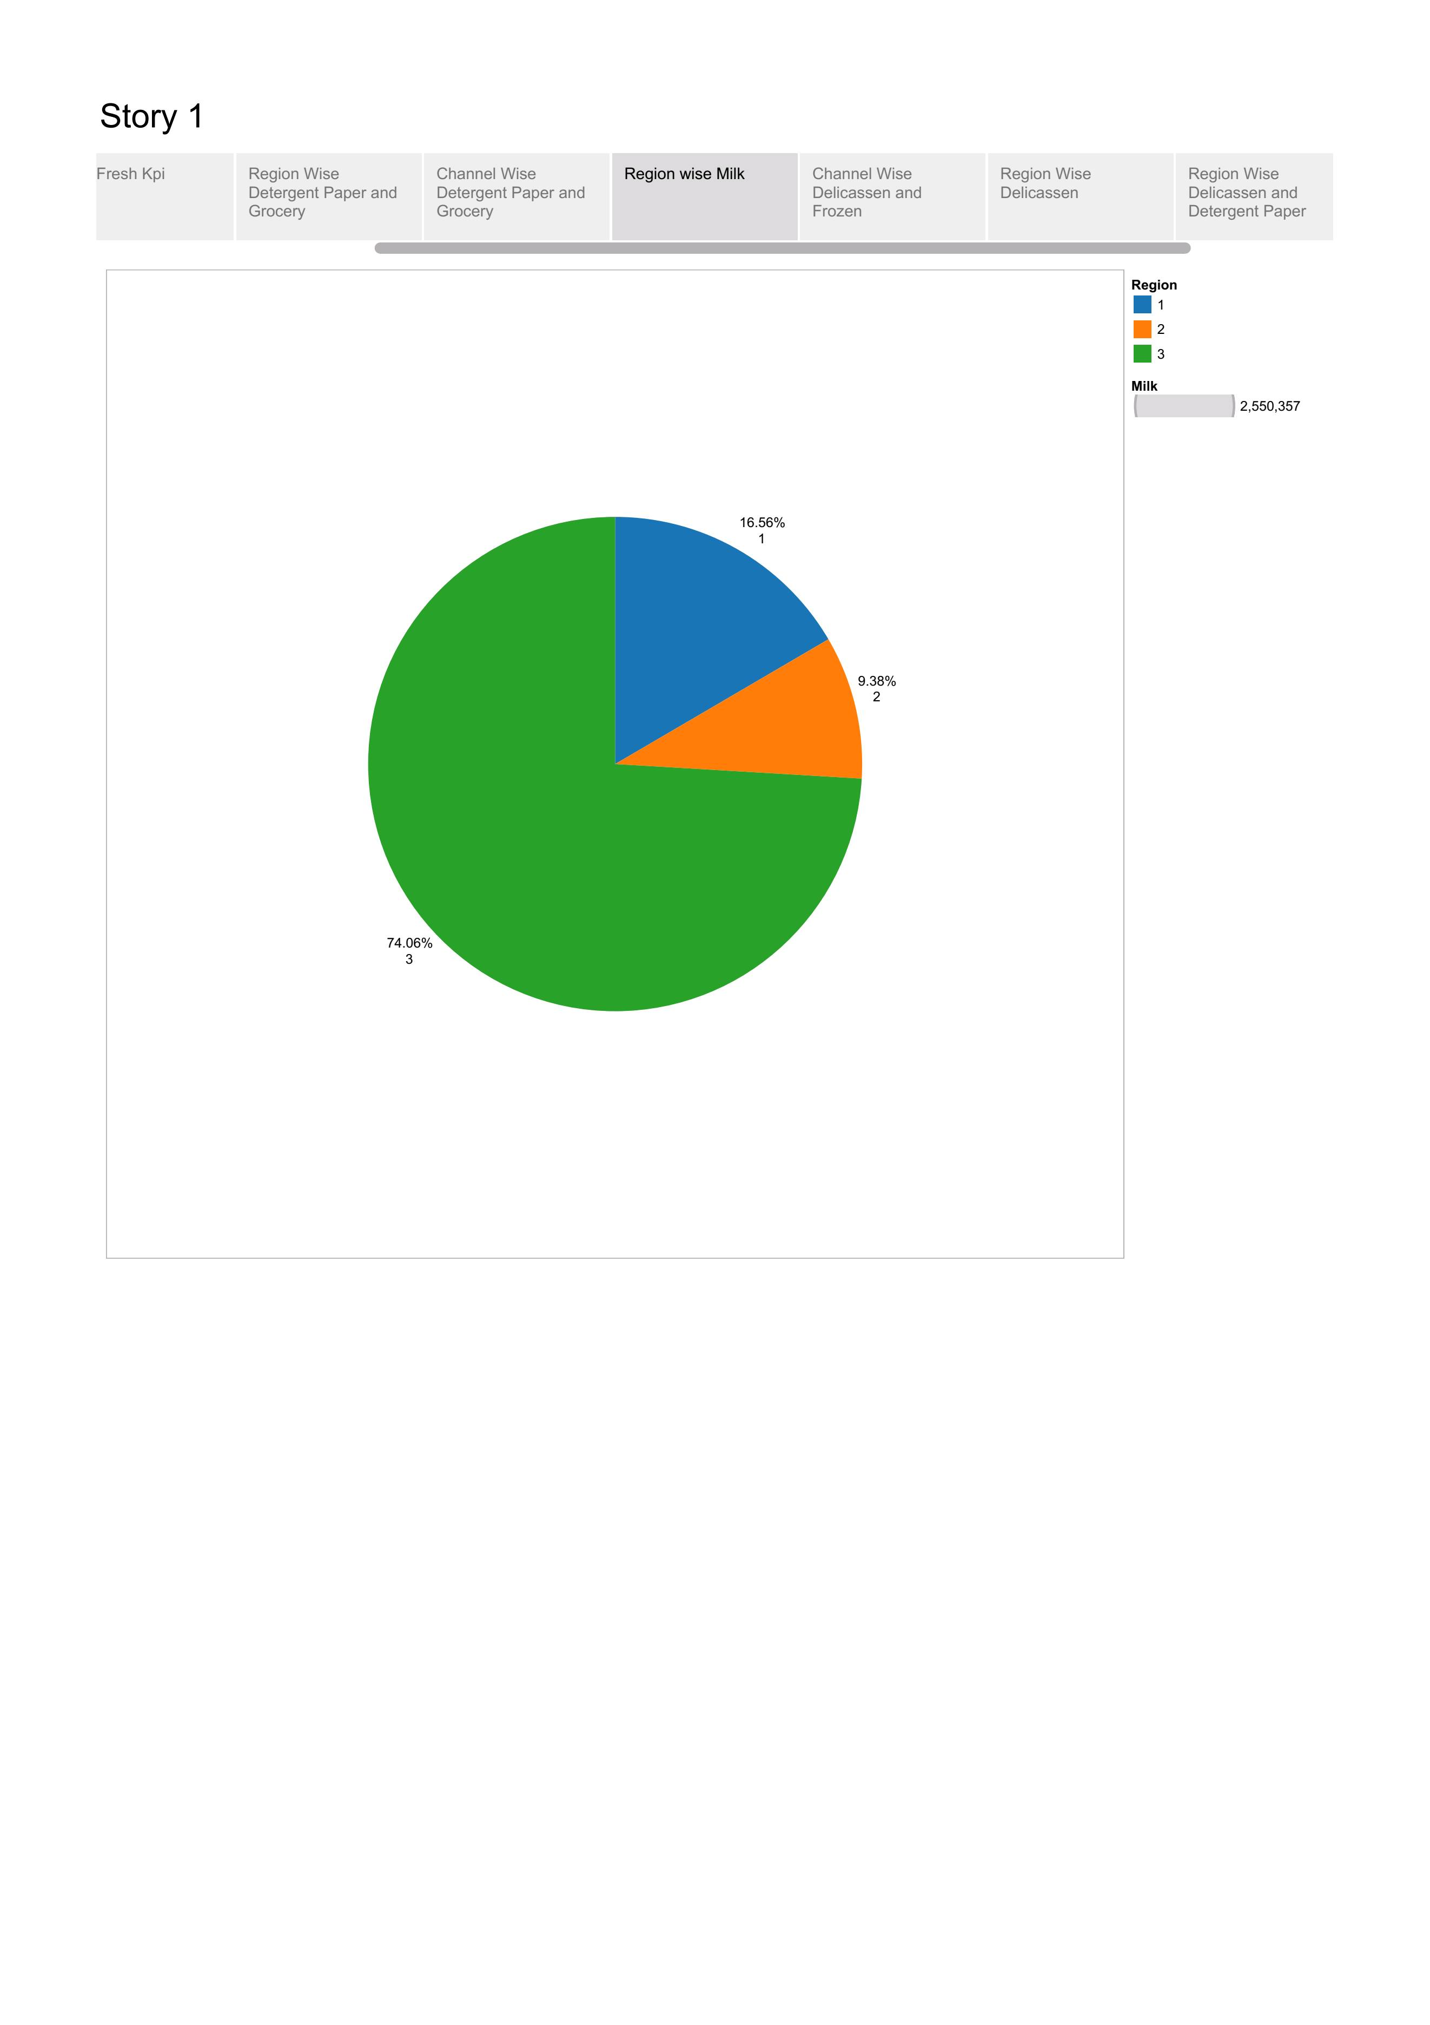
Region wise

Slide 13
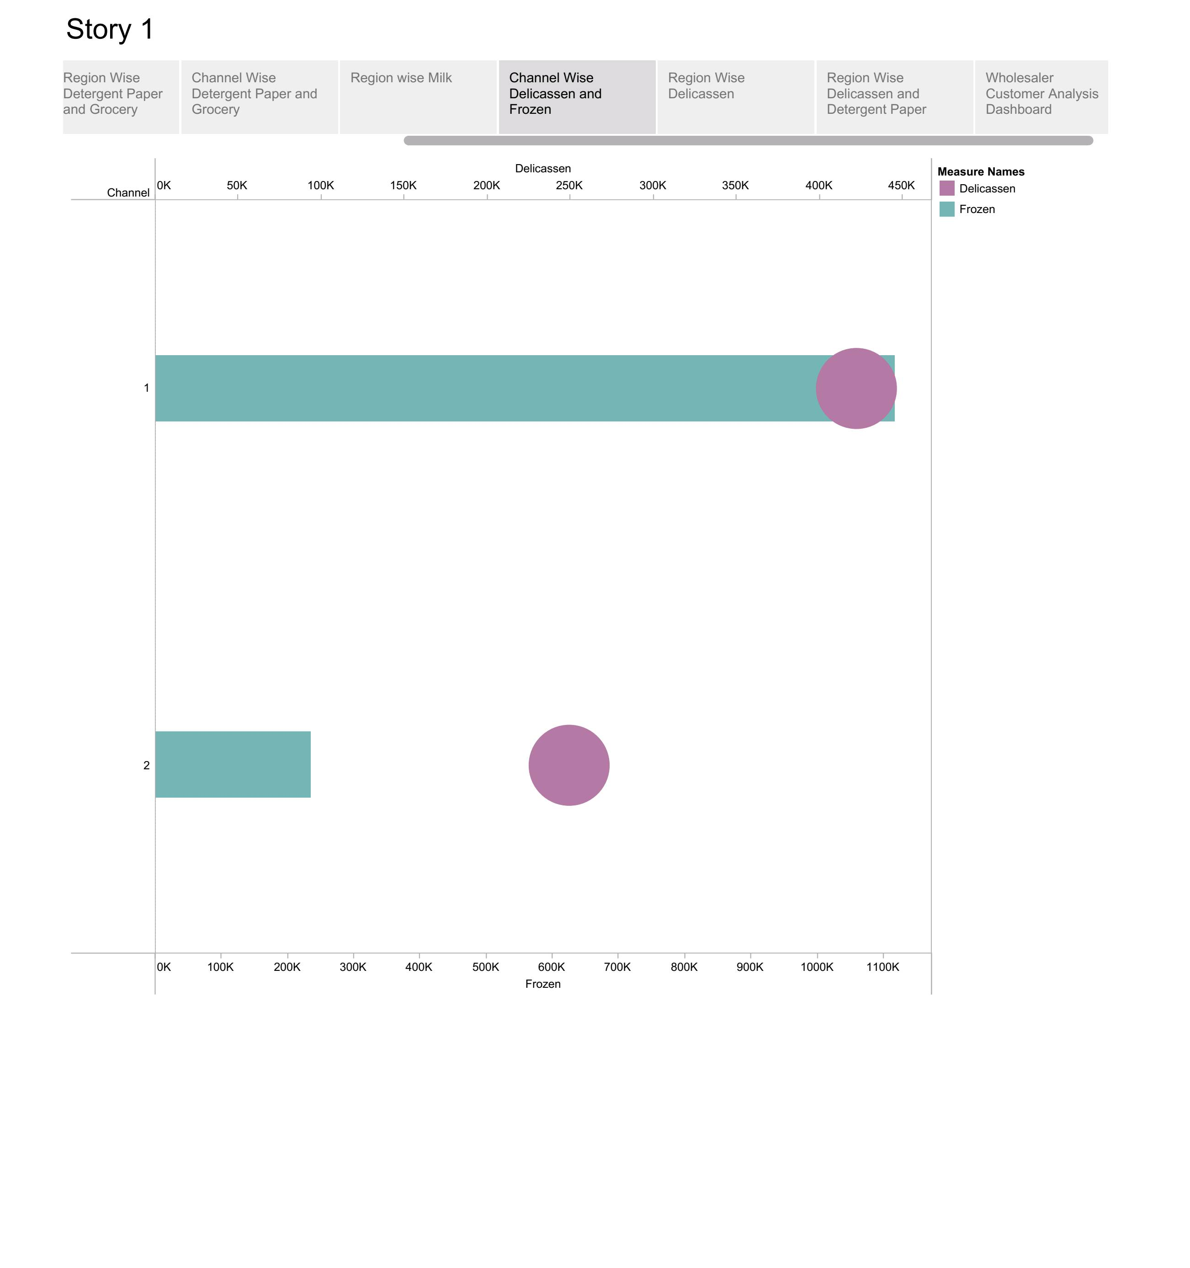
Channel wise Delicassen and Frozen

Slide 14
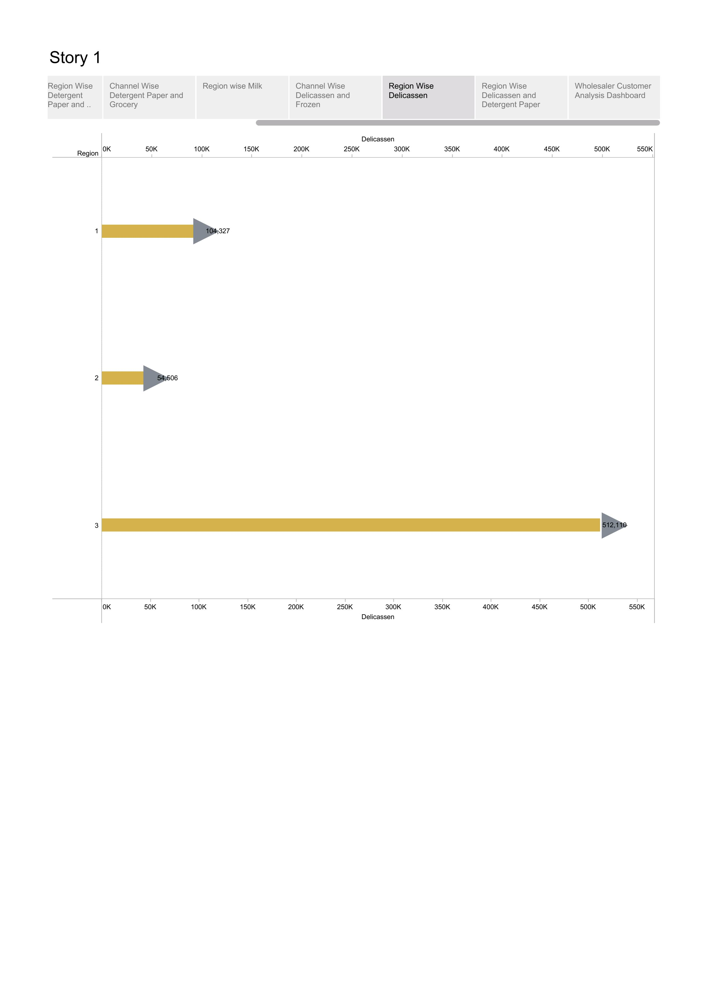
Region wise
Delicassen

Slide 15
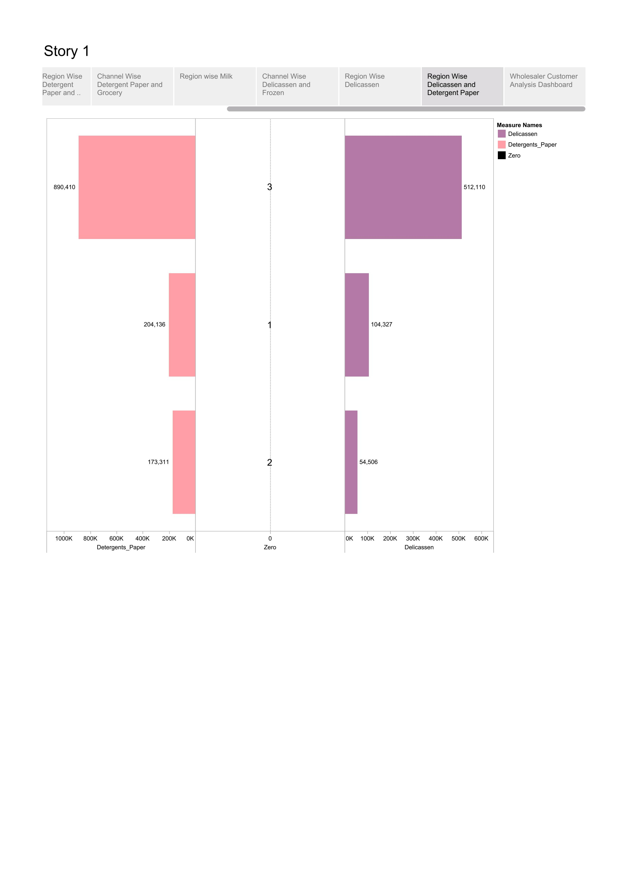
Region Wise
Delicassen and
Detergent Paper

Slide 16
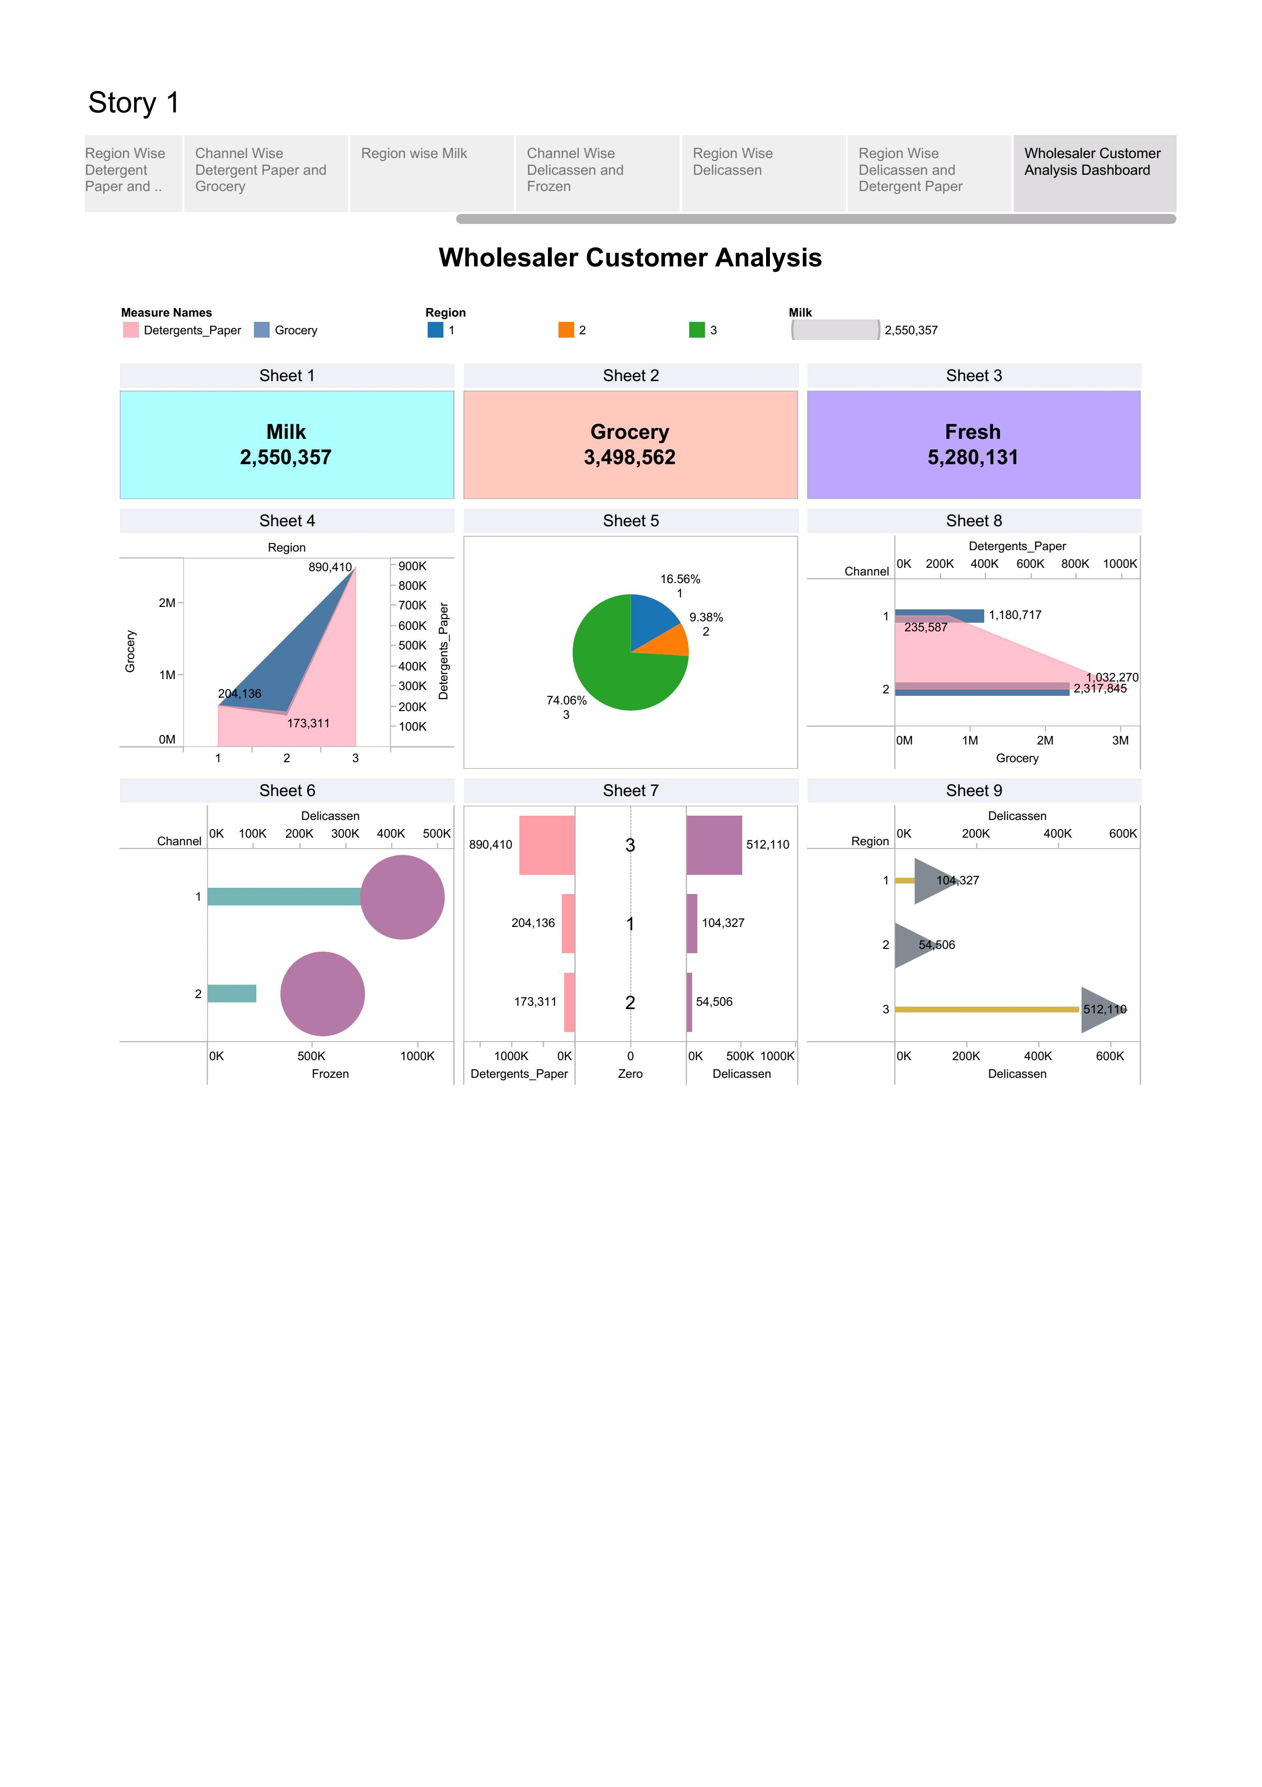
Wholesaler Customer Analysis

Slide 17
Advantages:
Market research provides significant advantages for business such as informed decision making targeted marketing and a competitive edge.
Business can learn about specific markets the potential for a service or products to succeed and patterns of consumer behaviour that may benefit their sales goods.
The biggest advantage of marketing analytics that helps business is that it allows you to take a more scientific approach to the market.
It helps to discover yours and your competitor’s strengths and weaknesses.
It identifies potential threats and opportunities.

Slide 18
Disadvantages:
Implementing a market research strategy can be expensive, especially for smaller business.
Another drawback of observational research is the risk of bias and subjectivity in the data collection and analysis process.
Respondents may not be fully aware of their reasons for any given answer because of lack of memory
Things like delays ,accidents, labor shortages, transport and delivery problems and other logistics and infrastructure challenges can be significant roadblocks for business when entering a new market.

Slide 19
Application:
Marketing analytics is a powerful tool that can help you make good decision but it’s not magic .
Use of marketing analytics to improve it’s website:-
Amazon has long been a leader in marketing analytics ,using its data-driven approach to continue innovating its website and product offerings. For example, they have used data from their customers to help them improve their search functionality, including personalizing results based on each user’s browsing history.
Using marketing analytics to make content recommendations:-
Netflix is another company that extensively uses marketing analytics to create content recommendations more likely to appeal to each viewer’s taste.

Slide 20
Conclusion:
The field of market research is continually evolving to meet the demands of an everchanging business landscape.
The process of evaluating the viability of a new service or product through research conducted directly with potential customers.
The market analysis report is document that reveals the characteristics of your ideal customers their buying habits, the value your product or service can bring to them and the list of your top competitors.

Slide 21
THANK YOU

